Slide 1

Smart ATM Machine
Submitted in the partial fulfillment for the
award of the degree of
BACHELOR OF ENGINEERING
IN
ARTIFICIAL INTELLIGENCE AND MACHINE LEARNING
Submitted by:
Bhanu Duggal 21BCS6292
Girish Chandwani 21BCS6277
Under the Supervision of:
Priyanka Kaushik Mam
Department of AIT-CSE
DISCOVER . LEARN . EMPOWER

Slide 2
Outline
Introduction
Problem Formulation
Objectives
Methodology
UI Design
Future Scope
Conclusion

Slide 3
Introduction to Project
The Smart ATM System is a modernized banking interface developed using TypeScript with React, aimed at enhancing user experience through advanced features and intelligent automation. This innovative ATM supports:
Multi-language interaction, ensuring accessibility for users from different linguistic backgrounds.
Multi-currency withdrawal and deposit, facilitating seamless international banking operations.
A Gold Sell System where users can deposit gold into the machine. The system automatically verifies the purity and credits the appropriate amount to the user’s account based on real-time gold valuation.

Slide 4
Why This Project?
🧳 Globalization has increased the need for accessible, multi-language and multi-currency banking solutions.
💬 Language barriers often hinder user interaction and trust in traditional ATM interfaces.
🪙 Gold selling is typically manual and inconvenient, needing digitization for faster, fairer transactions.
♿ Universal accessibility and a better user experience are crucial for inclusive financial services.

Slide 5
Problem Formulation
Challenges with Traditional ATM Systems:
🔄 Limited Currency Support: Most ATMs only support a single local currency, making international banking inconvenient.
🌐 Language Barriers: Lack of multilingual support excludes non-native speakers or tourists from using the service comfortably.
🏦 Manual Gold Selling Process: Users must visit banks or jewelers to sell gold, which is time-consuming, requires physical evaluation, and often lacks real-time value estimation.
🧑‍🦯 Accessibility Concerns: Many systems are not designed with universal accessibility in mind, limiting usage for people with different abilities.

Slide 6
Need for an Advanced Solution:
To bridge these gaps, there is a need for an intelligent, automated, and user-friendly ATM system that can:
Handle multiple currencies efficiently.
Provide language options for diverse users.
Integrate a smart gold evaluation and transaction system.
Be accessible and intuitive for users of all backgrounds.

Slide 7
Objectives of the Work
Develop an interactive ATM interface using Typescript with React, ensuring a modern and accessible UI.
Implement PIN authentication to enhance security and prevent unauthorized access.
Enable core ATM functionalities, including gold selling, cash withdrawal, deposits, and fund transfers.
Introduce multi-language support, allowing users to switch between English, Hindi, and French seamlessly.
Integrate multi-currency withdrawal capabilities, enabling users to withdraw Dollar, Euro, and Dirham, with an automated exchange rate calculation.

Slide 8
Enhance UI design by incorporating animations, color themes, hover effects, and responsive elements for an intuitive user experience.
Ensure security measures, such as real-time PIN validation and encryption, to safeguard user transactions and data.

Slide 9
Methodology used
Technology Stack:
Programming Language: Typescript with React,CSS
Tools Used – VS CODE, Git, Github
Security Features: PIN validation, encryption, and session management to prevent unauthorized transactions.
Implementation Steps:
User Authentication System - Implementing a secure PIN-based login system to ensure that only authorized users can access the ATM interface.
Main Menu Design - Creating a visually structured interface with options Gold Selling, Cash Withdrawal, Deposit, and Multi-Currency Transactions.

Slide 10
Multi-Currency Withdrawal Module - Allowing users to withdraw cash in Dollar, Euro, and Dirham, with real-time exchange rate calculations displayed.
Multi-Language Interface - Implementing dynamic language switching using translation dictionaries to enhance accessibility for diverse users.
User-Friendly UI Enhancements - Integrating smooth animations, color-coded buttons, and hover effects to create a modern, engaging interface.
Security & Validation Mechanisms - Implementing real-time transaction validation, error handling, and encrypted communication to prevent fraud and unauthorized access.
Testing & Feedback Analysis - Conducting usability tests with sample users to gather feedback, identify issues, and refine the UI for optimal performance

Slide 11
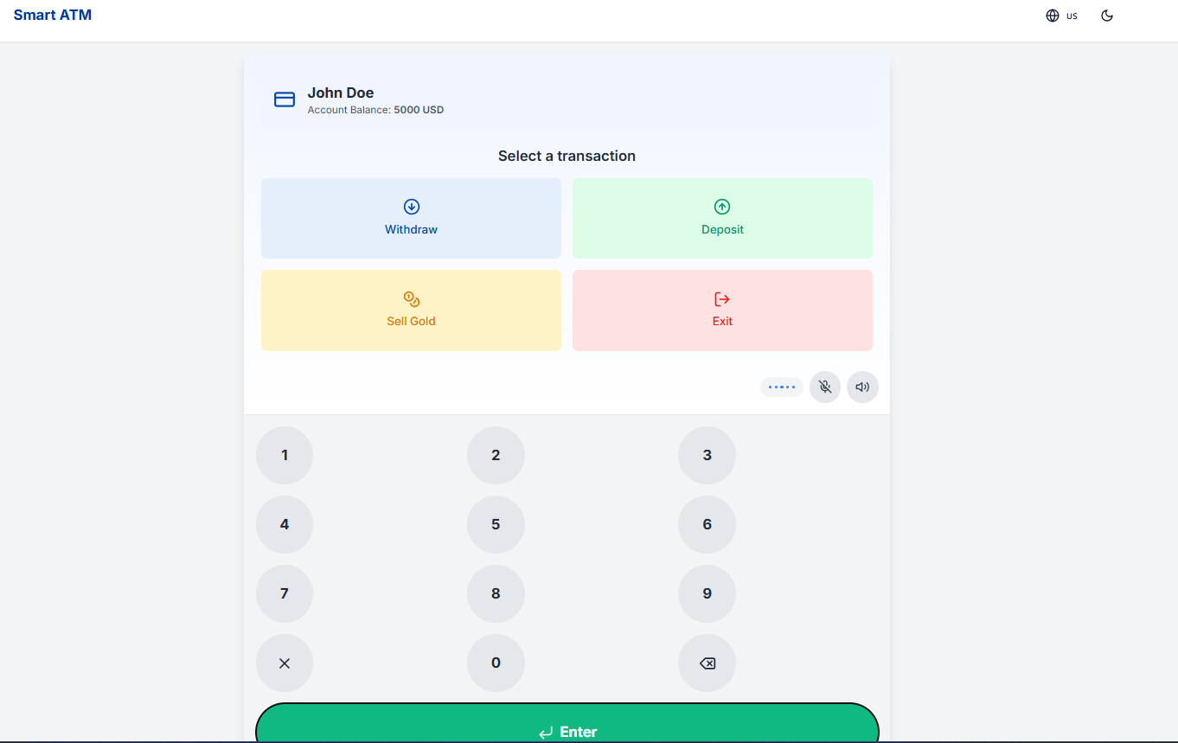
UI DESIGN

Slide 12
FUTURE SCOPE
🧠 Machine Learning for user behavior analysis to personalize ATM experience and security.
🔍 AI-powered fraud detection to prevent unauthorized transactions.
🌍 Blockchain integration for secure and transparent transaction records, especially for gold.
📱 Mobile sync so users can begin transactions on their phones and complete them at the ATM.

Slide 13
Conclusion
The Smart ATM System provides a next-generation banking experience
by integrating modern technologies and user-centric features.
It supports multi-currency operations, multi-language interfaces, and an automated gold selling process, making financial services more accessible and intelligent.
This solution bridges the gap between traditional ATMs and the evolving demands of modern users.

